Slide 1
Test Automation framework for PHP Travels
Team Lead: Shruti Kumari
Team Members:
L Rajyalakshmi
S Iswarya
S Siva Kumari
Punam Suryavanshi
Mayank Srivastava
K Surendra Kumar

Slide 2
Agenda
Test Case Design
Selenium & Cucumber Scripts
POM & Framework
Logs & Reports
TestNG

Slide 3
Introduction
Overview:
Brief introduction to the project
Purpose of the Modules in PHP Travels

Slide 4
Tools and Technologies & Technologies Used:
Test case design
Java
Selenium WebDriver
Cucumber
Pom design pattern
Hybrid frame work
TestNG
Log4j and extend report

Slide 5
Signup Module
➤ The user is on PhpTravels Homepage
➤ The user should click on Account and navigate to Sign-Up page
➤ The user should give all the valid details and click on Signup
Test Case Design
➤ The process of creating test cases that outline specific conditions, inputs, actions and expected results to verify that a system behaves as intended.
Cucumber
➤ Behavior-Driven Development (BDD) is supported by the open-source testing tool Cucumber.
➤ This enables the creation of test scenarios using simpie, accessible language for humans (Gherkin) Between technical and non-technical stakeholders, it serves as a bridge
➤ It includes terms like "feature," "scenario," "scenano outline." "given," "and," "when," and "then"

Slide 6
Example:
Feature: Signup
Scenario Outline:
Selenium:
It is a suite of open-source automated tests.
It is utilized for automating web applications on various platforms and browsers
it manages the browser by imitating user actions such as clicking, typing text, visiting pages.
Page Object Model (POM)
It's a design pattern that generates an object repository for web elements that
is used in test automation.
All of the application's pages or sections are represented by classes
It is made up of actions (such as clicks and inputs) expressed as methods and page
elements (such as buttons, fields, etc) defined as variables

Slide 7
TestNG
To control the execution of test cases, it has test methods annotated with @Test as well as additional annotations like @BeforeMethod, @AfterMethod, @BeforeClass, and @AfterClass.
A comprehensive overview of test execution is given in a TestNG report, which includes information on passed, failed, and skipped test cases.
It generates HTML reports by default, which include detailed logs, execution time, and test status, helping in identifying test failures and successes easily.
TestNG Listeners are interfaces in TestNG that let you listen to certain events (such as test start, test success, test failure, etc.) to customize and take control of the test execution lifecycle.
y using listeners, you can monitor how tests are running and carry out extra tasks like creating personalized reports, logging, snapping images when a test fails, or dynamically altering test behavior.
Behaviour-Driven Development
Behavior-driven development (BDD) is a software development methodology that focuses on the user experience and helps ensure that a product meets customer needs. BDD is an Agile practice that combines and improves on test-driven development (TDD) and acceptance testing.

Slide 8
Framework
A systematic and ordered collection of guidelines, procedures, and resources that direct the development, implementation, and administration of tests is known as a test automation framework.
Cucumber Reports
By displaying whether test scenarios passed, failed, or were skipped, these reports provide information on how well the system complies with the required behaviors. Several forms, including HTML, JSON, and JUnit XML, are generated for the reports.
Extent Reports
It is a well-known reporting package that creates incredibly thorough and adaptable test reports for automated testing. Selenium is one of the automation frameworks that may be linked with extent reports, TestNG and Cucumber
LOG4j
It enables programmers to record messages while an application is running, which can be useful for troubleshooting, debugging, and monitoring.

Slide 9
Blogs
Users can navigate to the blog page from the homepage(https://phptravels.net)
The "View More" button allows users to see additional blog posts.
When users select a specific blog from the list, the individual blog should open successfully.
Users are on the blog page and can see the blog content, title, image, and publication date.

Slide 10
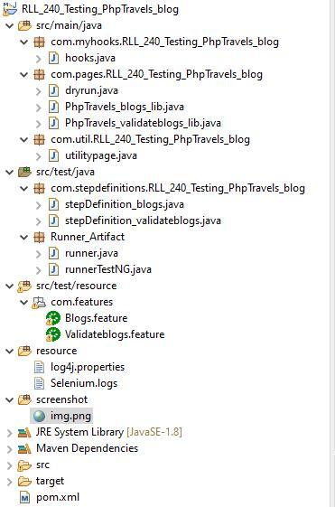
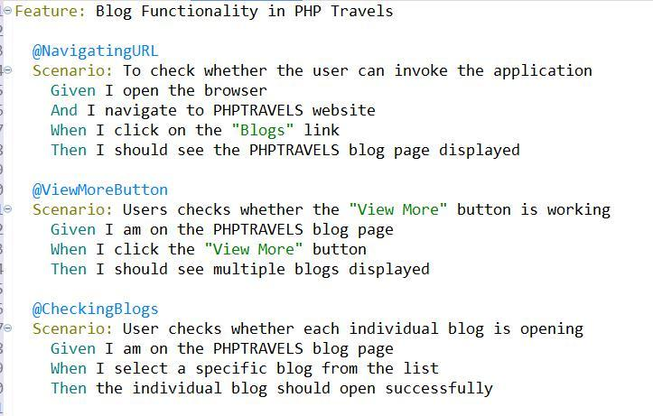
Cucumber scripts
Feature: What to Automate
Step Definition: How to Automate
Test Runner:

Slide 11
Hotels Module
The user is on PHP Travels Website.
The user clicks on Hotels from the list.
Give all valid details of Travellers and click on search
Then the user be able to see all available hotels.
After that, filter hotels according to rating & price.

